Slide 1
APT29
A Significant Threat to Healthcare
Content: Analyzing the Tactics of APT29 in Healthcare Cyberattacks
Presented by: Shaikh Sadik Rahman(12231823), Prabhu Ram Khadka(12268198), Sanjaya Poudel(12240769)
Course: Cyber Security Technologies

Slide 2

Getting to Know APT29
APT29, also known as Cozy Bear, is a well-known cyber espionage group linked to Russia's Foreign Intelligence Service (SVR).
They’ve been around since at least 2008, targeting governments, research institutions, and more recently, healthcare organizations.
APT29 gained a lot of attention for their role in the SolarWinds hack, but their activities extend beyond that, especially in stealing sensitive data.

Slide 3
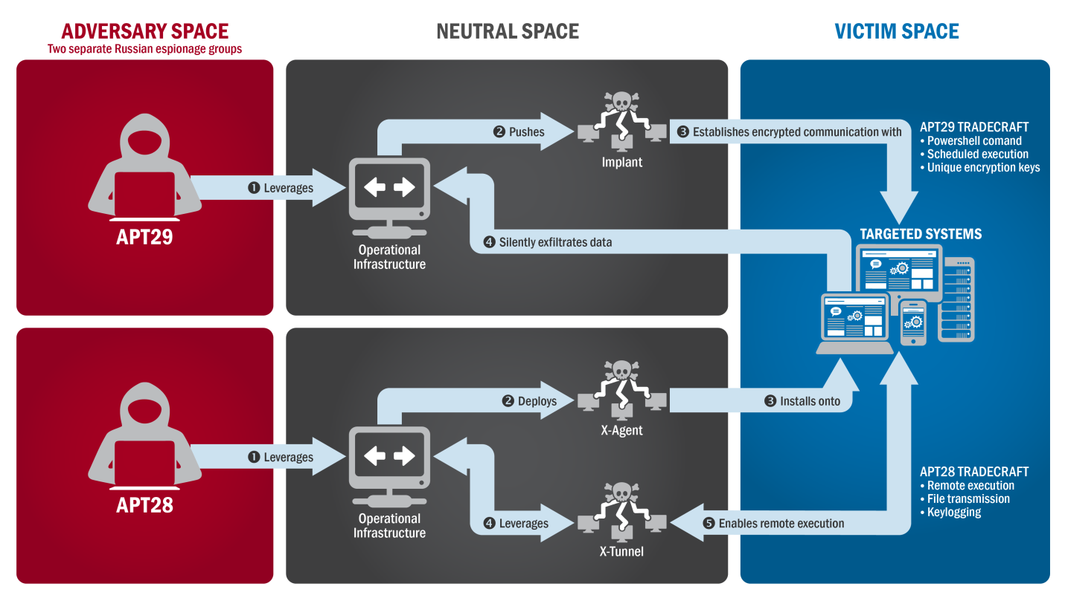
Lifecycle of an APT29 Attack
Overview: APT29 operates through a structured attack lifecycle, beginning with initial access and concluding with the exfiltration of valuable data.
Stages:
Initial Access: Often achieved through spear phishing.
Execution: Utilizes PowerShell for executing commands.
Persistence: Maintained by credential dumping and lateral network movement.
Exfiltration: Extracted data is securely transferred via encrypted channels.

Slide 4
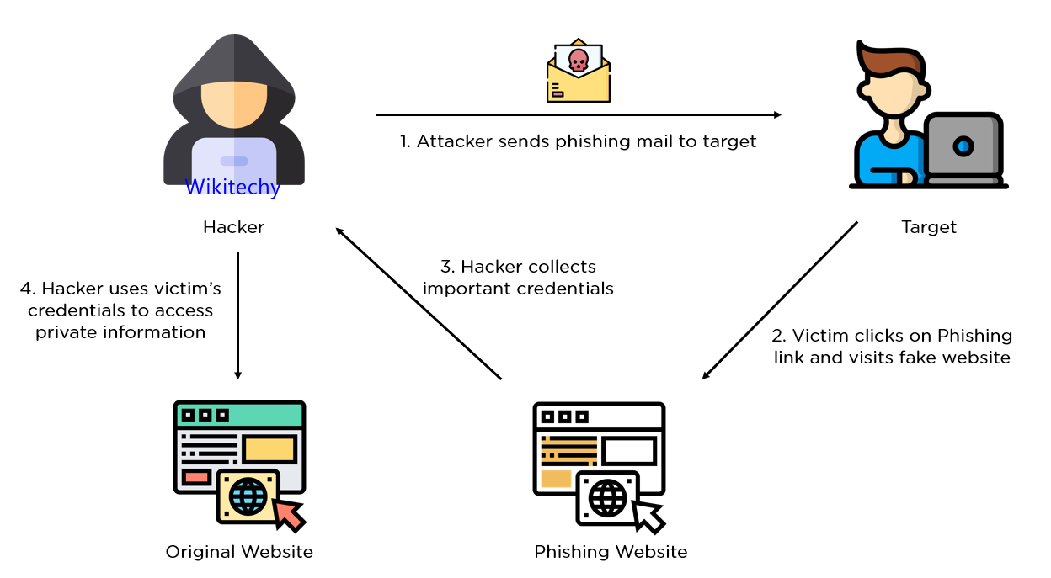
Phishing: Spearphishing Attachment (T1566.001)
Spear phishing : The First Step
APT29 is notorious for using spear phishing emails with harmful attachments to trick people into opening them. These emails often look like they come from trusted sources, such as health organizations.
In healthcare, they might send emails that look like COVID-19 updates or medical research papers to lure professionals into downloading malware.

Slide 5
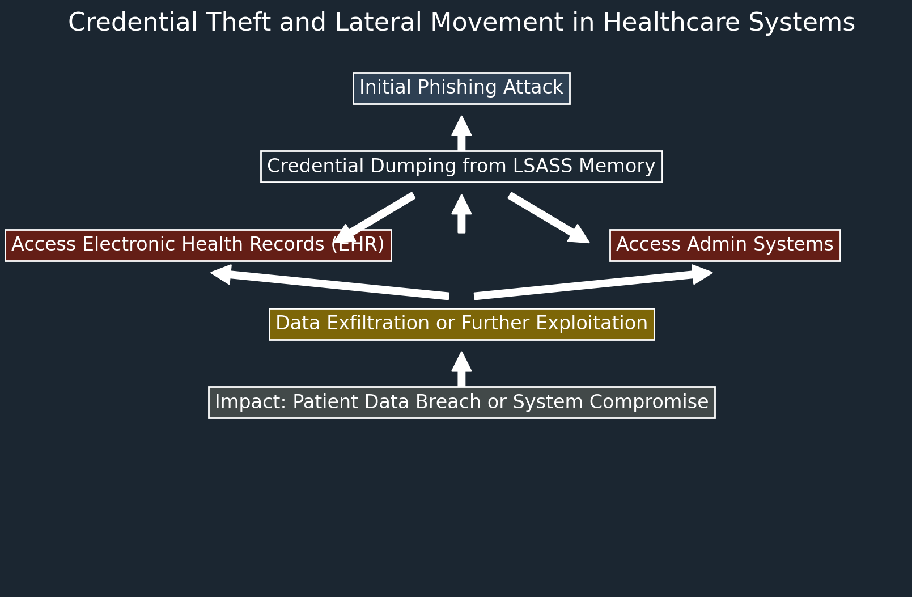
Credential Dumping: LSASS Memory (T1003.001)
Stealing Credentials: The Next Move
After getting in, APT29 often dumps credentials from the LSASS process, which is basically the memory that stores login details. This lets them capture usernames and passwords.
In a healthcare setting, this could mean gaining access to patient records, staff details, and more, allowing them to move deeper into the network.

Slide 6
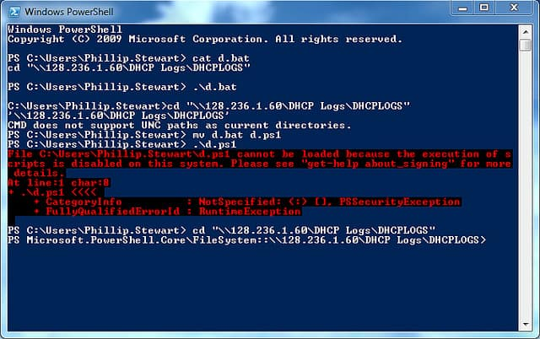
Command and Scripting Interpreter: PowerShell (T1059.001)
Using PowerShell to Control Systems
Content:
APT29 uses PowerShell, a powerful command-line tool, to execute commands on compromised systems. This can include disabling security features, running malicious scripts, and moving around within the network.
For healthcare systems, this could lead to serious disruptions, from disabling security protocols to potentially shutting down critical systems.

Slide 7
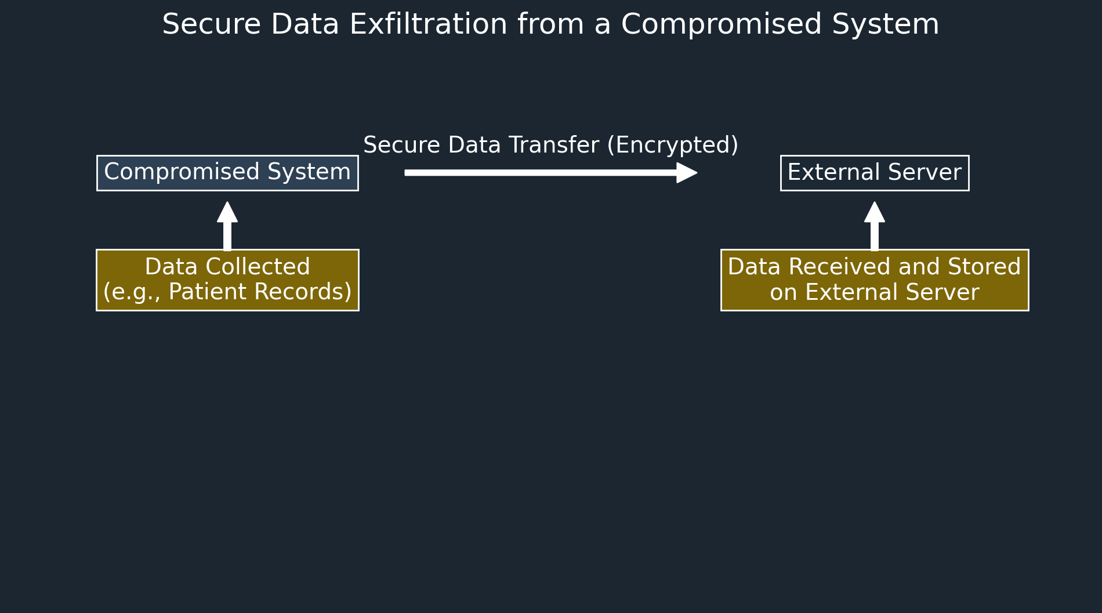
Exfiltration Over C2 Channel (T1041)
Stealing Data Under the Radar
Once APT29 has what they want, they often exfiltrate data using an encrypted Command and Control (C2) channel. This makes it really hard for security systems to detect what’s going on.
This technique is particularly dangerous in healthcare because sensitive patient data or proprietary research can be stolen without anyone noticing until it’s too late.

Slide 8
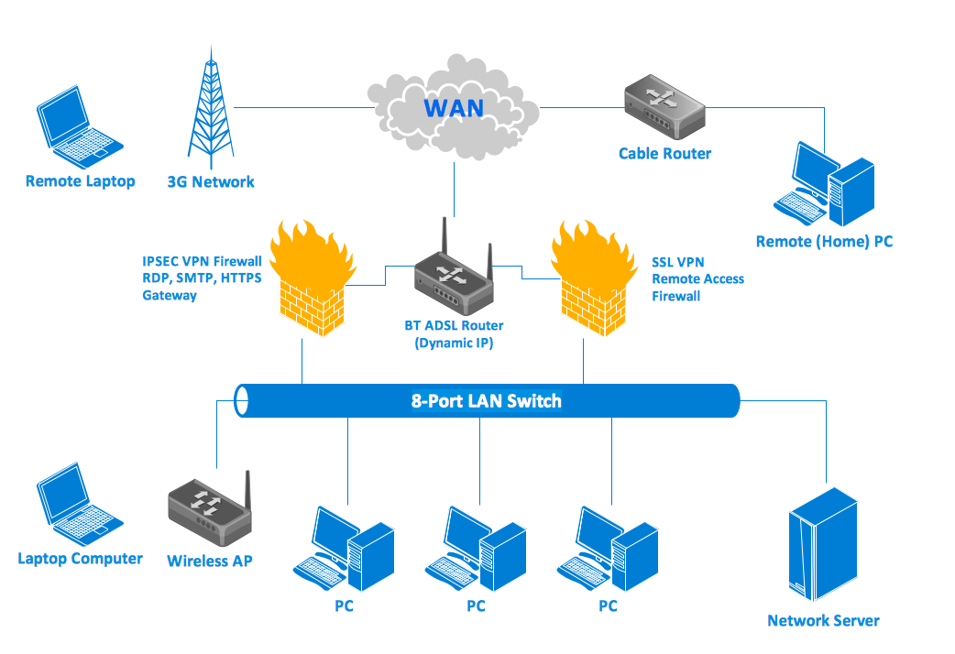
Ingress Tool Transfer (T1105)
Bringing in More Tools for the Job
After gaining a foothold, APT29 often brings in more tools or malware into the compromised network. This can include anything from ransomware to data-stealing programs.
In healthcare, this could mean deploying additional malware that could disrupt operations, steal more data, or hold systems hostage.

Slide 9
APT29 Threat Intelligence Report
APT29 utilizes five primary techniques to infiltrate and exfiltrate data from healthcare organizations.
Techniques Highlighted:
Phishing: Spear phishing Attachment (T1566.001)
Credential Dumping: LSASS Memory (T1003.001)
Command and Scripting Interpreter: PowerShell (T1059.001)
Ingress Tool Transfer (T1105)
Exfiltration Over C2 Channel (T1041)
Summary: These techniques showcase APT29’s ability to penetrate, persist within, and extract sensitive data from healthcare networks.

Slide 10
Rationale for Chosen Techniques
Phishing (T1566.001): Effective for initial access by exploiting human errors and trust.
Credential Dumping (T1003.001): Essential for lateral movement, enabling deeper network infiltration.
PowerShell (T1059.001): Highly flexible and difficult to detect, making it ideal for executing various malicious tasks.
Tool Transfer (T1105): Maintains the attacker’s presence and enables further exploitation of the network.
C2 Channel (T1041): Ensures secure and undetected exfiltration of valuable data.

Slide 11
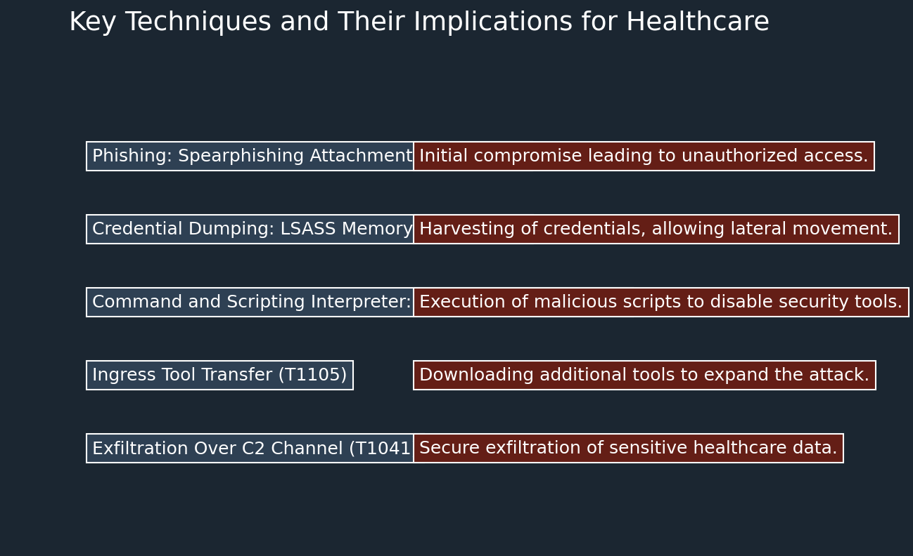
Conclusion
Why APT29 Is a Major Threat to Healthcare
APT29 is a formidable threat to the healthcare sector due to their advanced techniques and specific targeting of critical systems.
The techniques we’ve discussed—like spear phishing, credential dumping, and data exfiltration—show how capable they are of infiltrating, persisting, and stealing from healthcare organizations.
Understanding these tactics is key to defending against future attacks from APT29 or similar groups.

Slide 12
Where the Information Comes From
MITRE ATT&CK (2024) APT29 Group Profile. Available at: https://attack.mitre.org/groups/G0016/ (Accessed: 12 September 2024).
FireEye (2020) Highly Evasive Attacker Leverages SolarWinds Supply Chain to Compromise Multiple Global Victims With SUNBURST Backdoor. Available at: https://www.fireeye.com/blog/threat-research/2020/12/evasive-attacker-leverages-solarwinds-supply-chain-compromises-with-sunburst-backdoor.html (Accessed: 12 September 2024).
Mandiant (2022) Suspected Iranian Actor Targeting Israeli Shipping, Healthcare, Government and Energy Sectors. Available at: https://www.mandiant.com/resources/suspected-iranian-actor-targeting-israeli-sectors (Accessed: 12 September 2024).

